Slide 1

AI
INTERVIEWS
Presented By : Pushpender
Scenarios and Pros-cons
Version-2

Slide 2
1
TASK 1
Suppose ai is taking an interview a report for scenarios where problems might arise as a interviewer and interviewee and write pros-cons.
Time spent on this task:
Research work and scenario’s ideation : 3 hours
Converting ideas and scenarios in a PPT : 15 -20 minutes
PS | INTERNSHIP

Slide 3
2
SCENARIOS
1
Misinterpretation of Thinking Pauses
In human interviews, candidates may pause to think, which shows their analytical approach. Interviewers often encourage and guide candidates to provide a well-thought-out answer. However, AI may interpret these pauses as a lack of knowledge and move forward, potentially overlooking the candidate’s capability.
2
Mixed-Language Communication
Candidates sometimes mix languages, such as speaking Hindi within English responses. While human interviewers might not consider this a big issue, AI could classify it as informal or inappropriate, leading to biased evaluations.
Refrences: my personal experience from the interview given on Turing and YC Combinator

Slide 4
3
SCENARIOS
3
Understanding Examples and Analogies
Candidates often use examples or analogies to demonstrate their understanding of concepts. Human interviewers can interpret the intent and knowledge behind such responses, but AI might misclassify these as irrelevant or insufficient due to its training limitations.
4
Evaluating Imaginative Ideas
When asked, "Why should we hire you?" candidates might propose unique, research-worthy ideas. These could be innovative but still in the imagination stage, not present in existing datasets. AI, being bound by its training data, might fail to recognize and appreciate such originality.
Refrences: my personal experience from the interview given on Turing and YC Combinator

Slide 5
4
PROS OF USING AI
For Interviewer
For Interviewee
Faster Hiring process by faster resume shortlisting for each profiles and taking multiple interviews in less time as it does not need break.
Sometimes the interview is a bit far away or at a unpreferable time , making it difficult for the interviewee, this ai model will solve that.
AI will ask better questions to the candidate from their resumes as it vast knowledge it will be able to analyze all the data in the resume
AI will be able to analyse all the data from the user as it has better knowledge from web it will not have any problem in understanding terms and catch on.

Slide 6
5
CONS OF USING AI
For Interviewer
For Interviewee
Language barrier and inflexible with answers not directly related to the question asked.
for candidates not fluent in english and take their time in expressing their thought would have difficulty to answer with the time limit of ai
If a person comes up a unique accomplishment not directly related to the profile description, the AI might ignore it as it is not related the profile
AI interviewers lacks imagination and rely on data its trained, so if a candidate proposes a unique, innovative idea it might not understand it.

Slide 7
6
TASK 2
Some questions that came up in the meetings were:
One question might have multiple answers how to tackle it?
how do I cater hr questions?
AI-generated questions will get standardized after one point of time what to do with that?
Time spent on this task:
Research work and scenario’s ideation : 1.5 hours
Converting ideas and scenarios in a PPT : 15 -20 minutes
PS | INTERNSHIP

Slide 8
7
PROBLEMS AND SOLUTIONS
One question might have multiple answers how to tackle it?
First Solution
Based on the response of the user we need to find every correlation to the core concepts and ask a question based on the response
AI-generated questions will get standardized after one point of time what to do with that?
Second Solution
For the questions to not get standardized, we need to make it ask questions, not just based on their resume but also on his responses and behavior during the interview.
Refrence: the answer to these question is based on my experience and thinking

Slide 9
7
PROBLEMS AND SOLUTIONS
how do I cater hr questions?
First Solution
Asking questions based on the cultural and social background by training a model to ask questions like these
Second Solution
for problem-solving and analytics skills it’s better to cross-verify their projects and review them by cross-questioning thoughts/responses of the interviewee

Slide 10
6
TASK 3
Some questions that came up in the meetings were:
How to better check a candidate?
Problems faced in an AI interview due to AI from both interviewers and interviewees perspectives?
Time spent on this task:
Research work and scenario’s ideation : 2 hours
Converting ideas and scenarios in a PPT : 20-25 minutes
PS | INTERNSHIP

Slide 11
8
HOW TO BETTER CHECK A CANDIDATE
1
In the interview asking them questions of a different natures instead of just one nature going cont. , asking them in a alternate and combined way will bringout the candidates true nature and responsive abilities.
2
Asking both technical questions from the projects in their resumes and asking about their experience of the project to better check their involvements.
Cross Question based on the response given by candidate.
3
Asking them how they can fulfill the job requirements and help in growing the company. this will help in checking their perspective and knowledge about the profile and company needs.
Refrence is from google search and personal opinion

Slide 12
PROBLEMS FACED DUE TO AI
9
FROM INTERVIEWERS PERSPECTIVE
Problem
Solution
The AI might skip a question and misinterpret the answer due to halts, missing out on well-thought-out answers, leading to incomplete evaluations.
Increasing tolerance of AI to the time of silence and making the AI to encourage the candidate might help.

Slide 13
PROBLEMS FACED DUE TO AI
10
FROM INTERVIEWERS PERSPECTIVE
Problem
Solution
Marking the question’s answer to be incorrect or inappropriate due to mix-language usage missing out good candidates.
Including examples of mixed-language communication in AI training datasets to ensure mixed- language answer understanding.

Slide 14
PROBLEMS FACED DUE TO AI
11
FROM INTERVIEWERS PERSPECTIVE
Problem
Solution
AI Might classify some responses (given as examples, Imaginary and references) as off-topic, potentially discounting valuable insights.
Training the AI model to recognize examples and analogies to correlate with the question asked.

Slide 15
PROBLEMS FACED DUE TO AI
12
FROM INTERVIEWEES PERSPECTIVE
Problem
Solution
Candidates might be hesitant or unprepared if their thinking is slow and are not given enough time to answer.
This can be solved by providing interviewee better time limits to answer say like 30 sec for thinking and then answering time.

Slide 16
PROBLEMS FACED DUE TO AI
13
FROM INTERVIEWEES PERSPECTIVE
Problem
Solution
The answers of interviewees in mixed language might not be completely interpreted by the AI making them lose an opportunity
pre- informing the candidate about language and converting into single language before handed by userside

Slide 17
PROBLEMS FACED DUE TO AI
14
FROM INTERVIEWEES PERSPECTIVE
Problem
Solution
The innovative ideas, analogies, of the person getting labeled as irrelevant or misunderstood might effect overall judgement
using a model trained to identify those analogies and asking the candidate about the analogy or imagination to get a better idea of what is being conveyed.

Slide 18
15
TASK 4
Problem statement:
looking at the CV of someone, can we suggest a missing skill set w.r.t. to job market thrust and can we recommend a learning path or roadmap to achieve a goal
Time spent on this task:
Research work and Ideation: 1.5 hour
Implementing multiple ideations: 4.5 hours
Converting ideations and Work in a PPT : 35 minutes
The fully implemented solution can be found here : Link
PS | INTERNSHIP

Slide 19
16
STEPS TO SOLVE THE PS
1
Extracting the text from Pdf of CV and JD and Pre-Process the text
2
Finding the skills from the text
3
Finding the missing skills from CV required in JD
4
Getting a proper guide/Roadmap to develop that Missing Skill

Slide 20
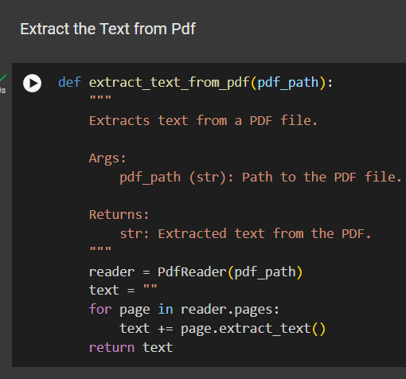
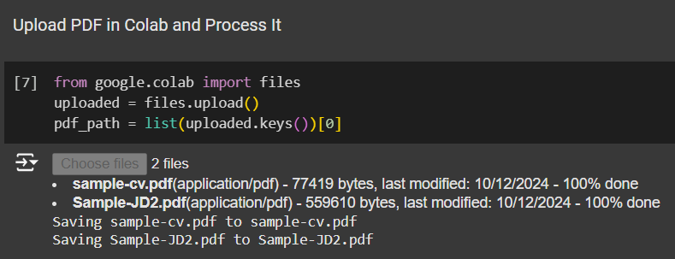
17
STEP 1: EXTRACTING THE TEXT FROM PDF OF CV AND JD AND PRE-PROCESS THE TEXT
1
Upload the files to collab
2
Use PDFReader to read the pdf and extract the text
3
Defining the function for the above task
Refrence : colab notebook at: https://colab.research.google.com/drive/100dUGCo3Fu500Mp8vUICoskxbuzth3Um?usp=sharing

Slide 21
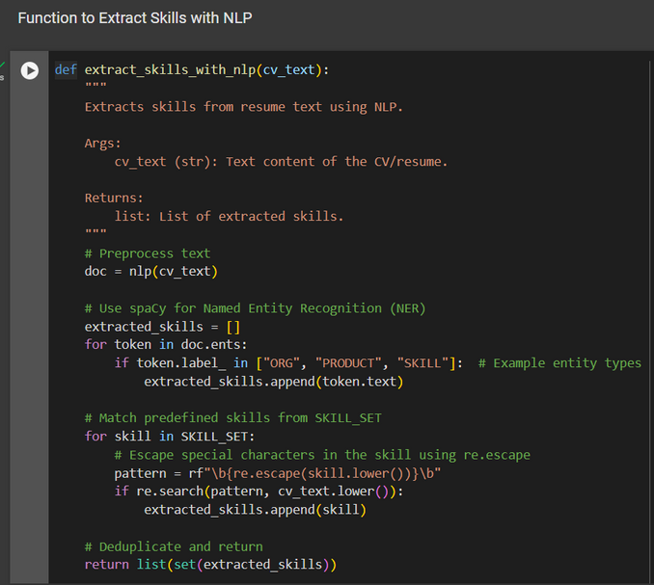
18
STEP 2: FINDING THE SKILLS FROM THE TEXT
To find the skills from text there are two ways defined
below first one I used.
1
We can define the skill set that Our company demand and requires and then map those skills in text extracted from pdfs in this we have to take care of a skill thatcan be named in multiple ways
2
We can do the same task using a fine-tuned LLM which Iwas thinkingof doing but didn’t have time and resources to that we can fine-tune a model to extract the skillset not just the explicit ones also the implicit one
Refrence : colab notebook at: https://colab.research.google.com/drive/100dUGCo3Fu500Mp8vUICoskxbuzth3Um?usp=sharing

Slide 22
19
COMPARISION BETWEEN METHOD 1 AND METHOD 2 IN THE PREVIOUS SLIDE
In the first one,
limited skill search
have to define all the possible skill name that one skill might have
exclusive search of skills our company requires
In the second one,
high range of skill search
can find a skill implicitly and explicitly given in cv
gives a larger skill set that might contain not necessary skills which are not required in the company

Slide 23
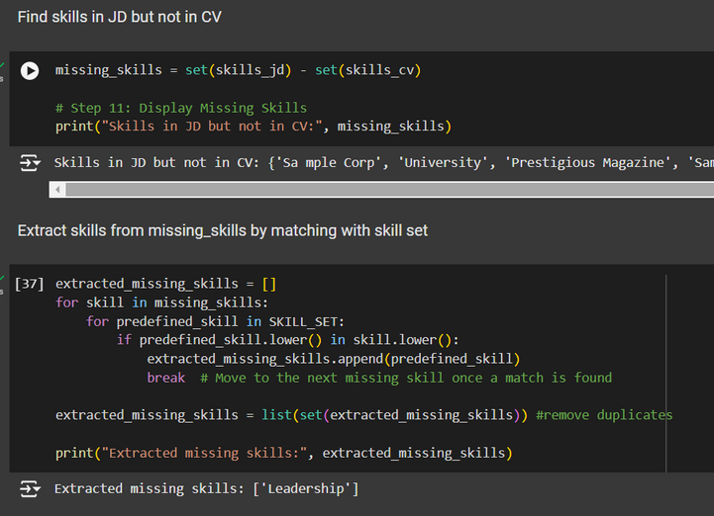
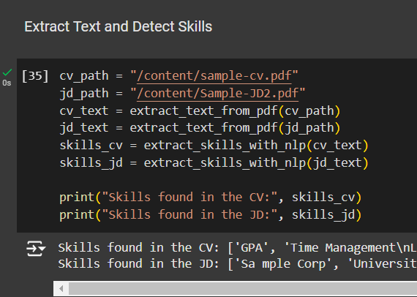
20
STEP 3: FINDING THE MISSING REQUIRED SKILLS
To find the missing additional required skills from requirement in JD which are not in the cv.
1
Just find make 2 skill sets one of skills in JD and one of skills in CV.
Then just remove the ones from jd which are in the CV along with the noise in the JD skill set.
This will result in the missing skill set
2
Refrence : colab notebook at: https://colab.research.google.com/drive/100dUGCo3Fu500Mp8vUICoskxbuzth3Um?usp=sharing

Slide 24
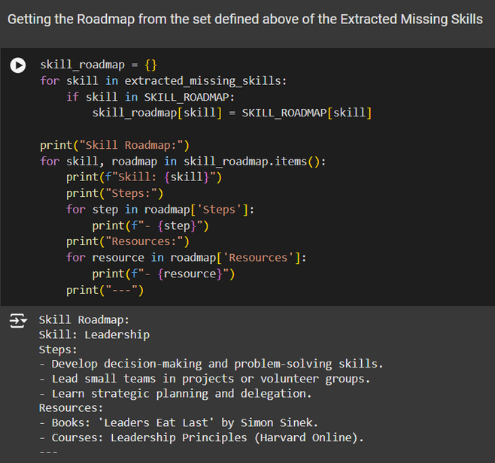
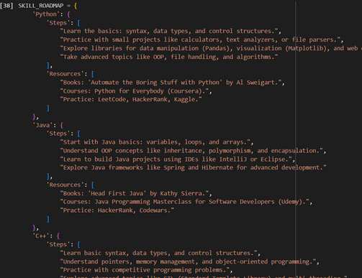
21
STEP 4: FINDING THE SKILLS FROM THE TEXT
To give a roadmap for the mssing skills development there are two ways defined
below first one I used.
1
We can define the skill development roadmap dictionary of the skills Our company demand and Just give those roadmaps of the missing skills.
We can fine-tune a model to generate a roadmap to develop a personalised roadmap based on the current skill set to develop that skill in shortest possible time
2
Refrence : colab notebook at: https://colab.research.google.com/drive/100dUGCo3Fu500Mp8vUICoskxbuzth3Um?usp=sharing

Slide 25
22
COMPARISION BETWEEN METHOD 1 AND METHOD 2 IN THE PREVIOUS SLIDE
In the first one,
limited roadmaps search
have to define all the roadmaps for all the skills
not a personalised roadmap based on other skill set
will be an exclusive roadmap of the company
In the second one,
larger range of roadmap generation
can make a personalized roadmap based on other skills to learn the skill in shortest time.

Slide 26
PS | INTERNSHIP
THANK YOU
Presented By : Pushpender

